Slide 2
Welcome and Housekeeping – Mhairi Wylie

Slide 3
Introduction to Crowdfunding
Inverness 23rd August 2019
Tim Wright
www.twintangibles.co.uk
@twintangibles

Slide 4
Crowdfunding is a method of raising money from a distributed group of funders (the crowd) who provide a large number of small sums forming a significant total when collected together.

Slide 5
DONATION
LENDING
REWARD
EQUITY
Four Models of Crowdfunding

Slide 6
DONATION
Funds collected are gifts or donations with no tangible return to the provider.

Slide 7
REWARD
“Rewards” or “perks” of different value are offered to supporters to purchase.

Slide 8
LOAN
A loan is constructed from many small loans collected from the crowd. Many are interest bearing.

Slide 9
EQUITY
Shares are sold in small parcels to a large group of investors.

Slide 10
DONATION
LENDING
REWARD
EQUITY

Slide 11
Platforms

Slide 12
It’s so much more than money!

Slide 13
FUNDING
INSIGHT
Seed
Growth
Matching
Cashflow
Project based
Rapid
Patient
Market size
Concept
Acceptability
Validation
Brand perception
Price points
Innovation
COMMUNICATION
NETWORK
Visibility
Awareness
Marketing
Advertising
Campaigning
PR
Experts
Distributors
Partners
Collaborators
Advocates
Customers
Team

Slide 14
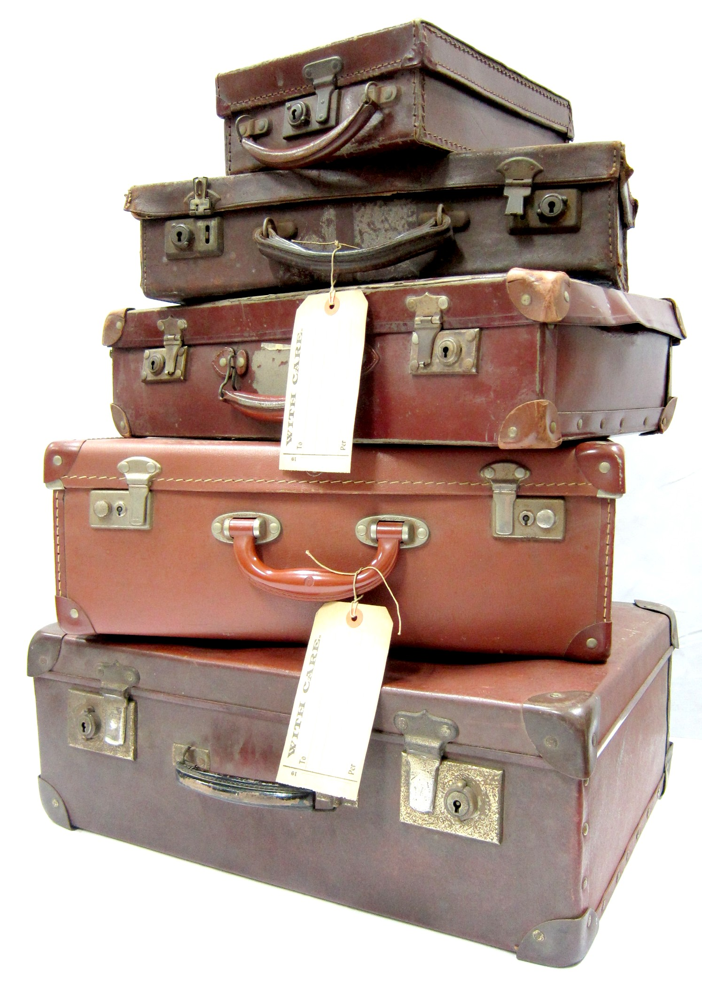
A Few Cases

Slide 15
“Pledge £100
for
a loaf of bread
every week
for 1 year”
Needed
£8,000
For Oven
Raised
£8,690
From 114
people
Leeds Bread co-op

Slide 16
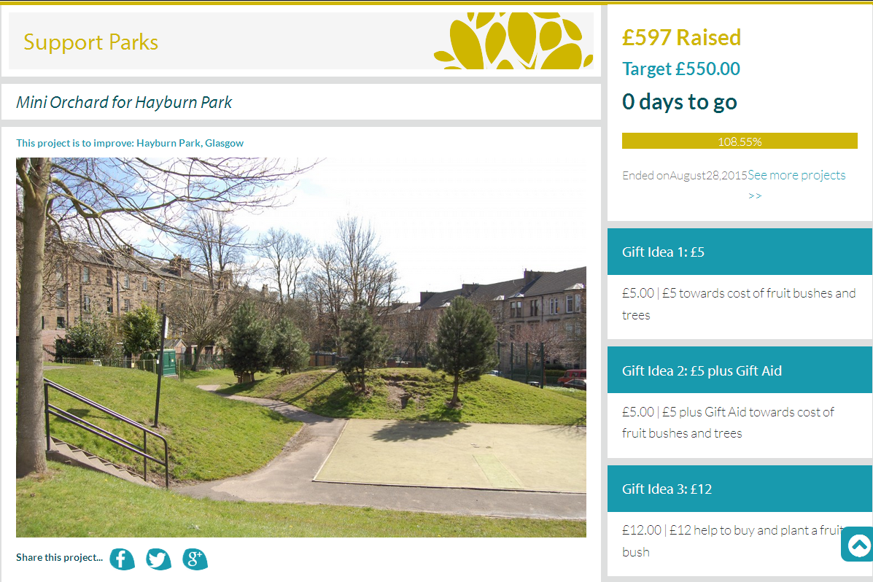

Slide 17
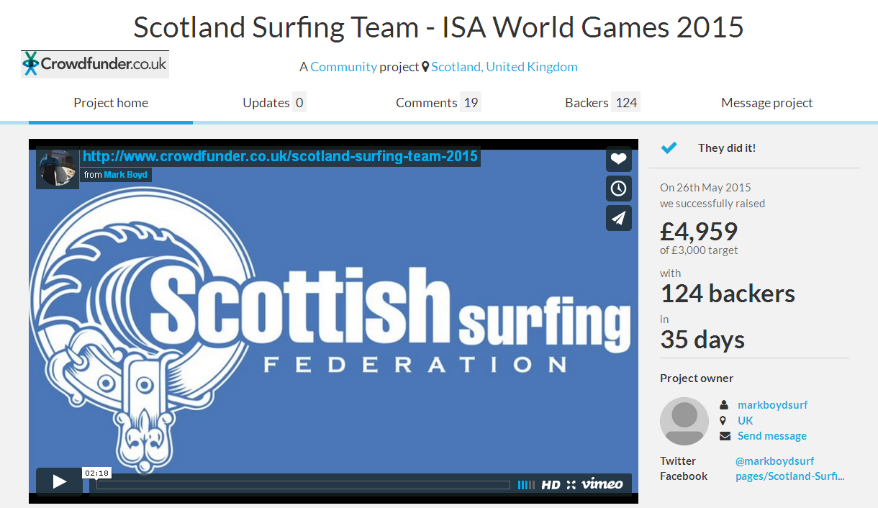
28
REWARDS
RANGE
£10 - £3,000
2
CAMPAIGNS

Slide 18
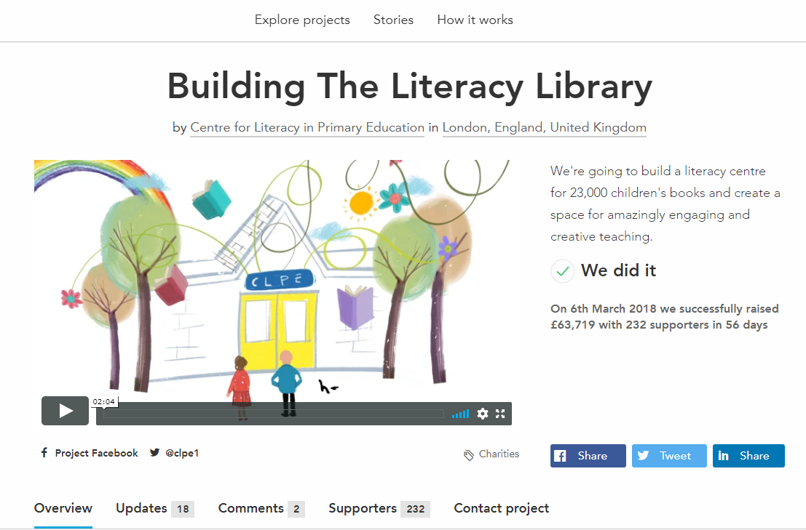
Sponsorship
REWARDS
CORPORATE
BACKERS
£15K
Santander

Slide 19
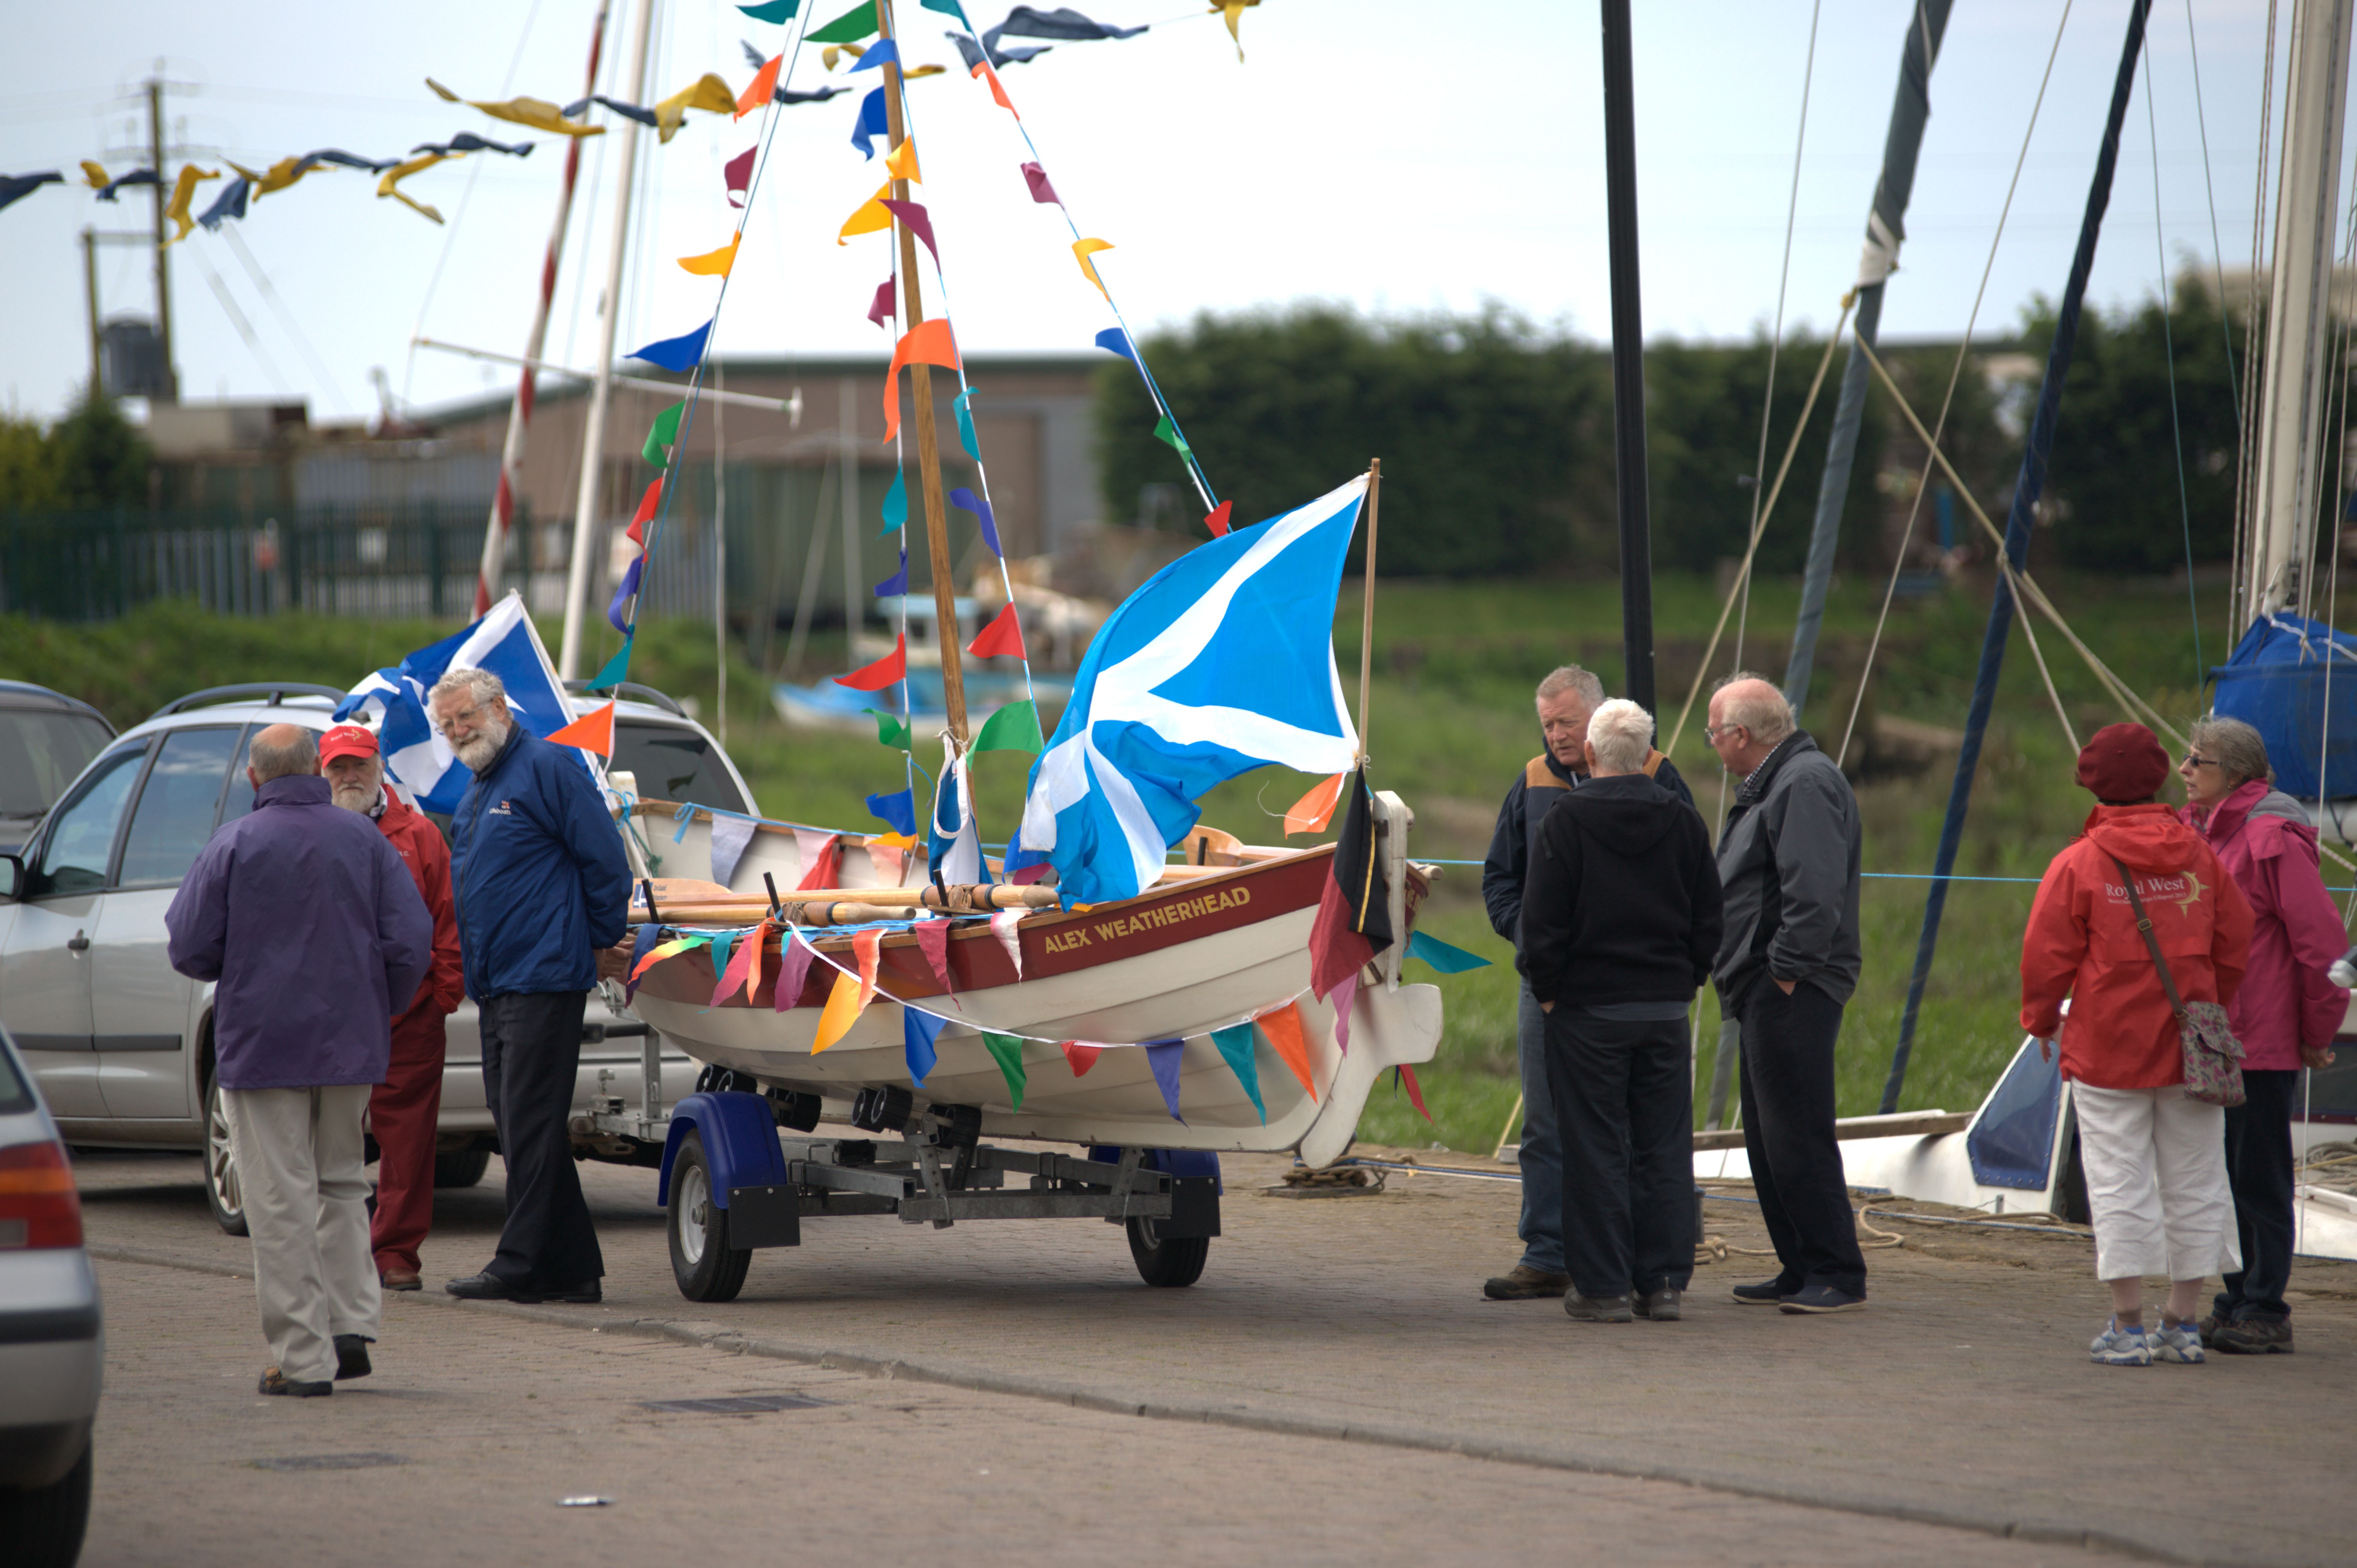
£6,002
the crowd
+
TOTAL RAISED
£43,302
Crowd raised £6,002
Received £36,000
£4,500
Envirocentre
skills pledge
+
£10,300
Local
Council
+
£22,500
FLAG
Match
Funding
Annan Harbour
Reward Crowdfund

Slide 20
How To Do It & Some Top Tips!
Tim Wright
www.twintangibles.co.uk
@twintangibles

Slide 21
The TAMP Process
T Targets
A Audit
M Method
P Plan/Prepare
Phase 1
Phase 2

Slide 22
TARGETS

Slide 23
FUNDING
INSIGHT
Seed
Growth
Matching
Cashflow
Project based
Rapid
Patient
Market size
Concept
Acceptability
Validation
Brand perception
Price points
Innovation
COMMUNICATION
NETWORK
Visibility
Awareness
Marketing
Advertising
Campaigning
PR
Experts
Distributors
Partners
Collaborators
Advocates
Customers
Team

Slide 24
AUDIT

Slide 25
Audit
Assets
Skills
Resources
Tools

Slide 26
Social Capital
Relationship Capital

Slide 27
METHOD

Slide 28
Method
Model
Form
Platform
Reward
Equity
Lending
Donation
All or nothing
Keep it all
Duration
Crowdcube
Kickstarter
MyParkScot
Funding Circle
DIY

Slide 29
PLAN & PREPARE

Slide 30
Resource development
Testing messaging
Due diligence
Identifying targets
Building awareness & anticipation
Before
During
Promotion & outreach
Maintaining momentum
Growing & deepening
Tracking, responding & reflecting
After
Fulfilling & thanking
Retaining
Nurturing and growing
Exploring & harvesting
3 Planning Phases

Slide 31
Things to Bear in Mind

Slide 32
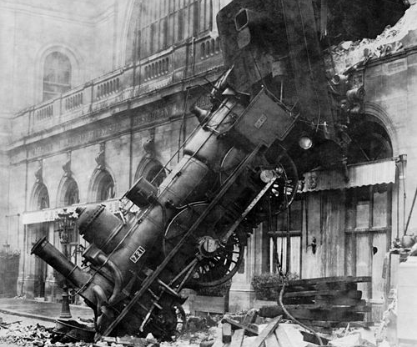
70%
CROWDFUNDING
CAMPAIGNS
FAIL

Slide 33
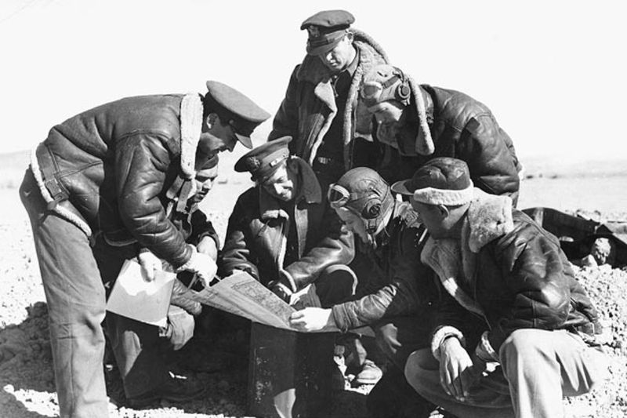
You need a plan

Slide 34
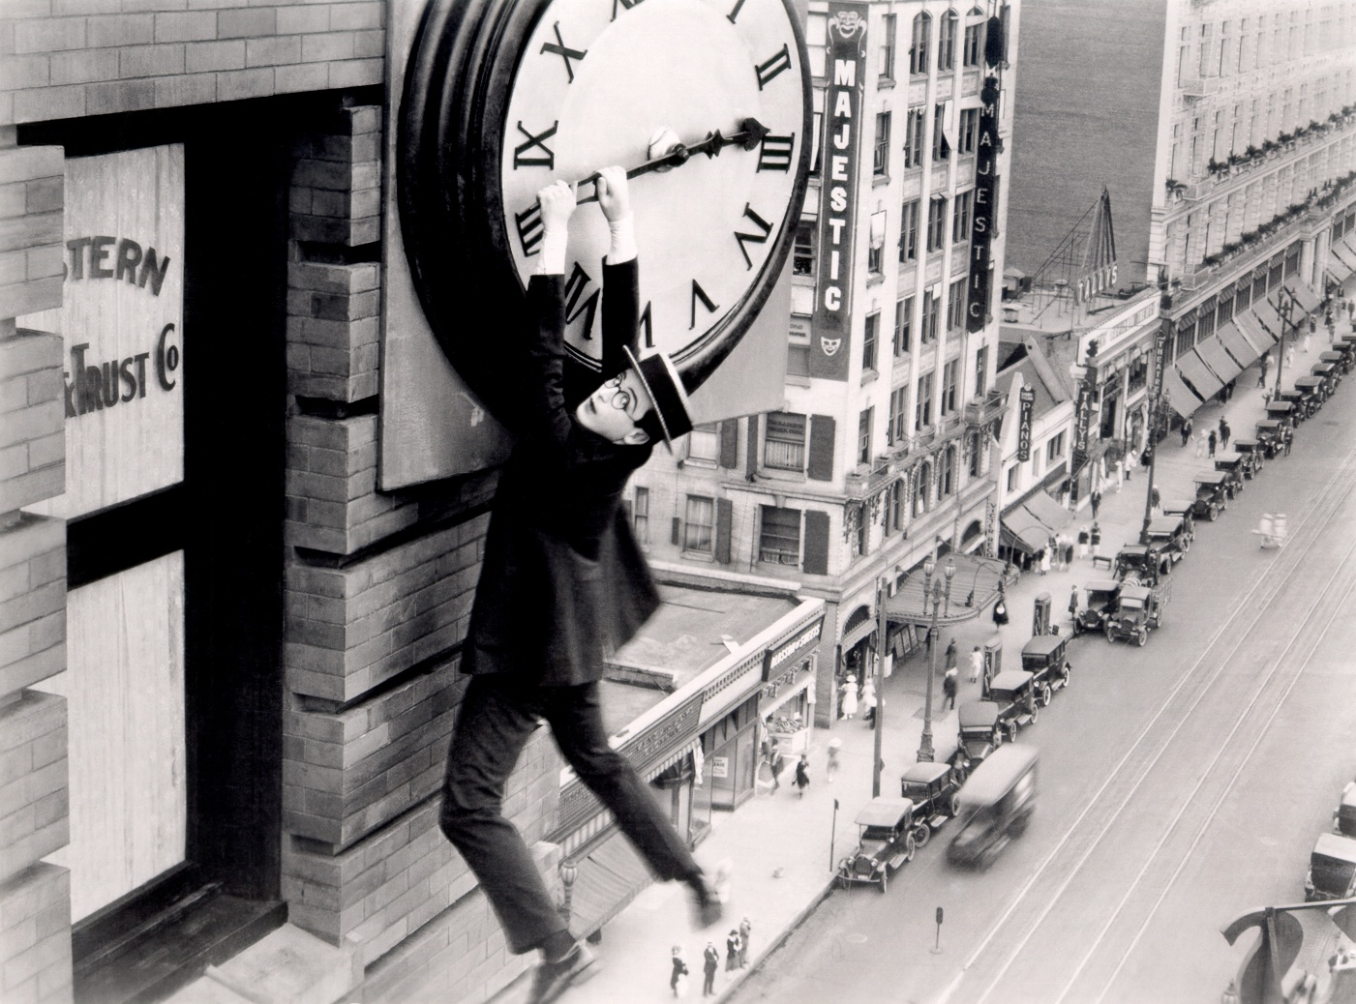
It takes time

Slide 35
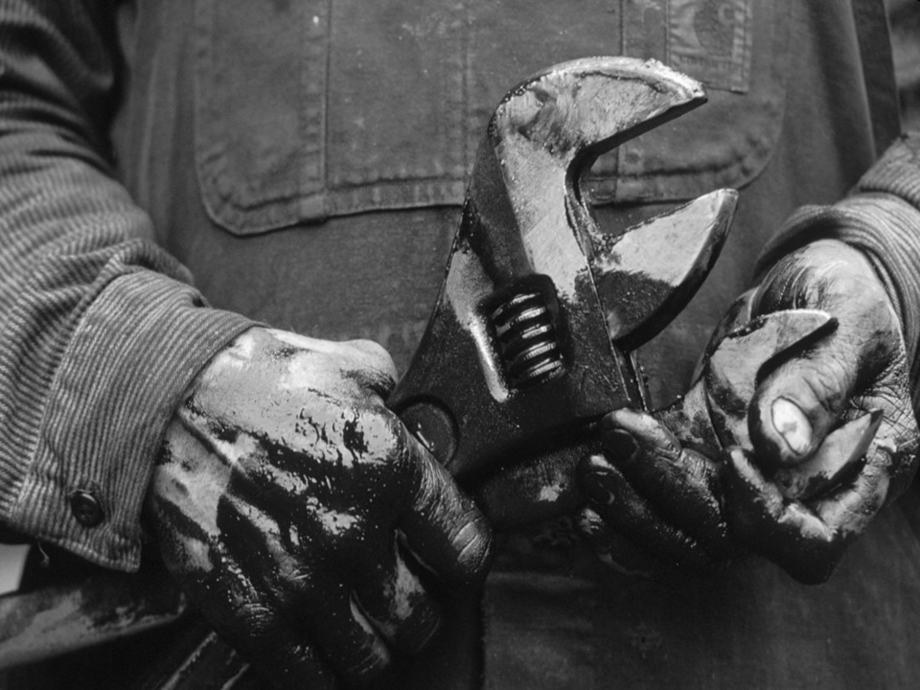

Slide 36
It is not for the fainthearted

Slide 37
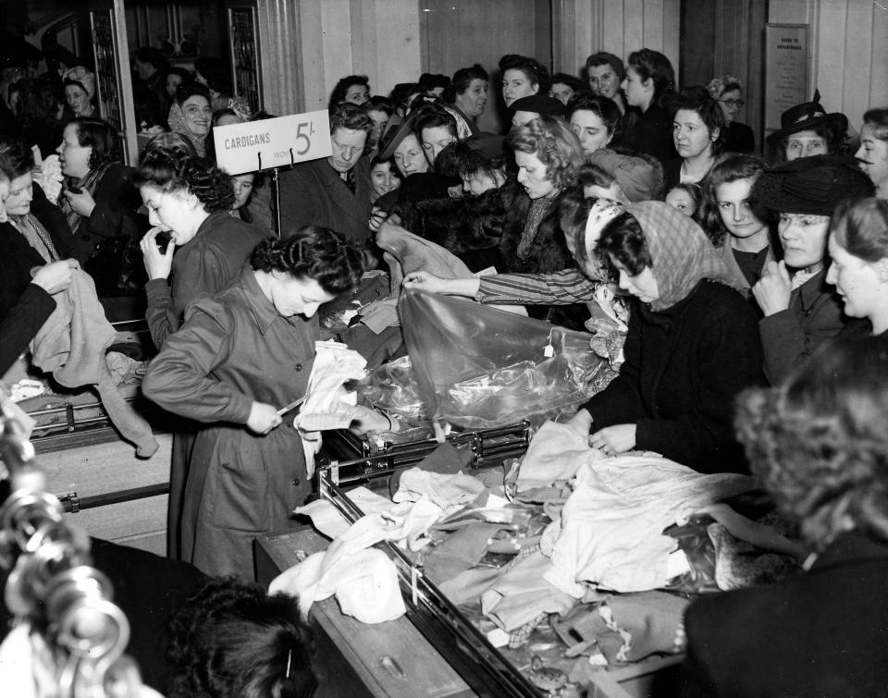
It is not about selling

Slide 38
Some Top Tips

Slide 39
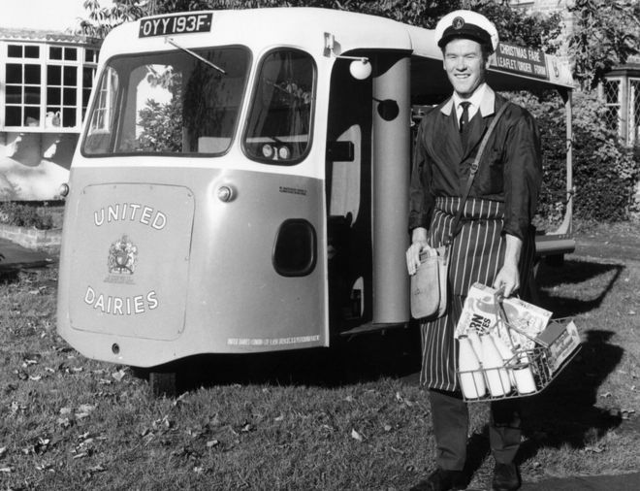
Get started early

Slide 40
LISTEN!!!!!!

Slide 41
Cost your
campaign

Slide 42
Facets matter

Slide 43
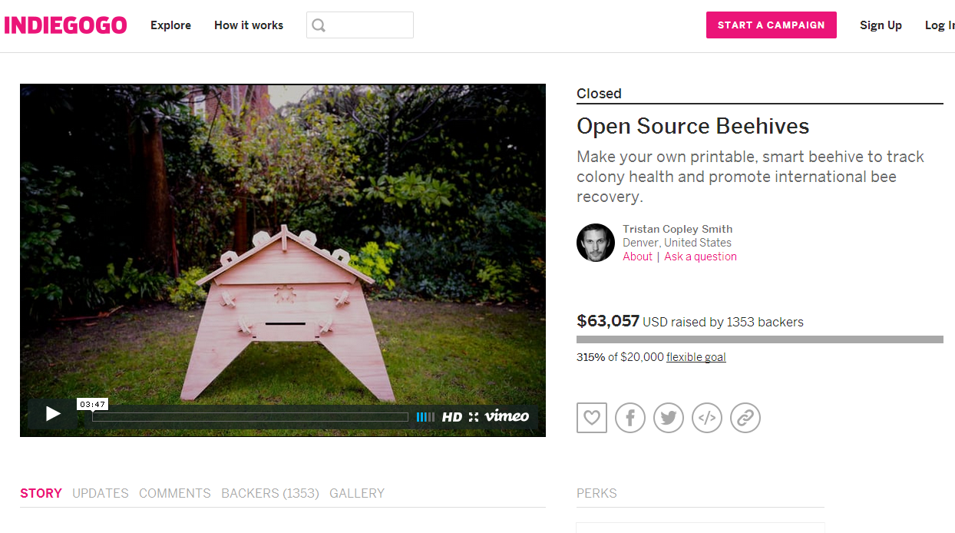

Slide 44
Finding your
CROWD

Slide 45
Followers
Influencers
Communicators
Primary
Secondary
Tertiary

Slide 46
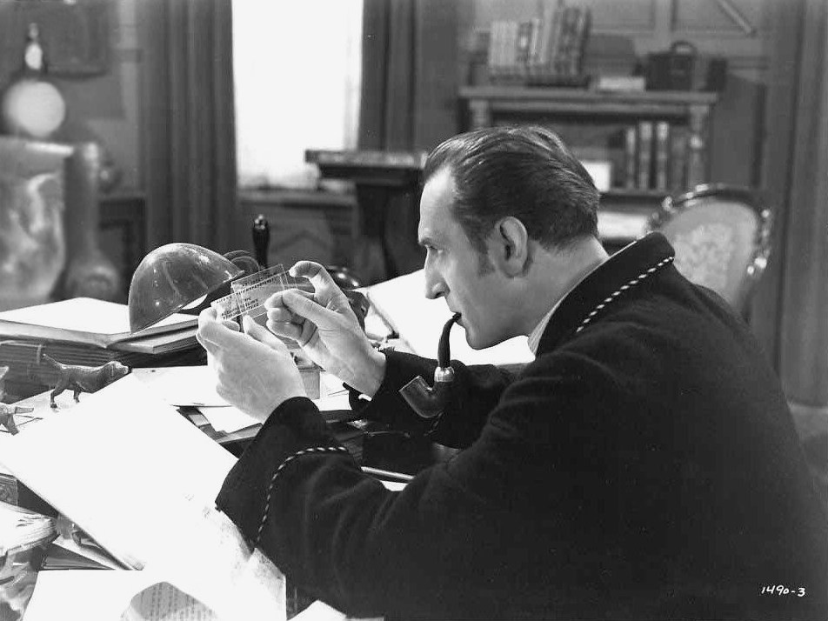
Do some research

Slide 47
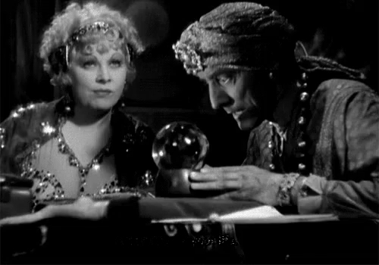
You can predict

Slide 48
Work It Out
Required
Conversion
Total
TOTAL
=
Avg. Pledge
Likely
Conversion
Total
Social
Capital
X
5%
X
1%
=
LCT > RCT

Slide 49
£10,000
=
RCT
1,000
£10
10,000
X
5%
X
1%
=
LCT
5
LCT > RCT
?

Slide 50
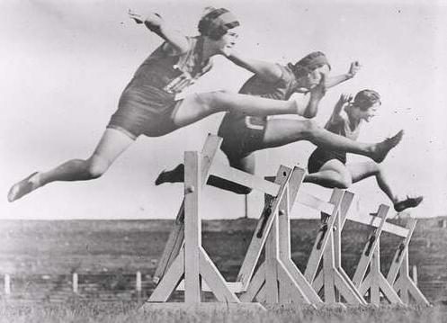
Get a Good Start

Slide 51
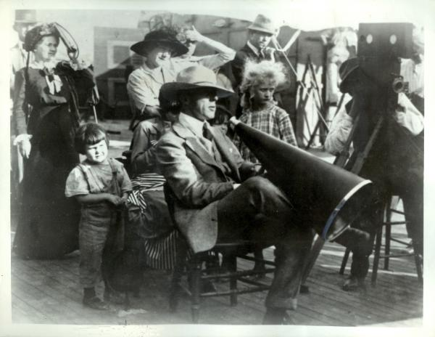
Make a Video

Slide 52
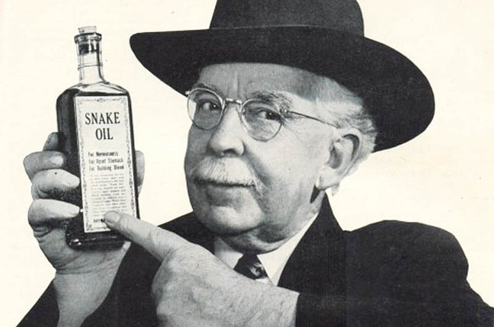
BEWARE!

Slide 53
Introduction to Crowdfunding
Inverness 23rd August 2019
Tim Wright
www.twintangibles.co.uk
@twintangibles

Slide 54
Title
Content

Slide 55
Title
Content

Slide 56
Title
Content

